Slide 1

Newton Cooling in the Attic: Applying ODEs at Home
Dan Kalman
American University (emeritus)
www.dankalman.net

Slide 2
Cold Air Problem
Water pipes run through an attic crawl space
Cold air infiltration under high wind conditions
Solution: create insulated enclosure around the pipes
Question: How cold a sustained temperature can be tolerated in the crawl space w/o risking frozen pipes?

Slide 3
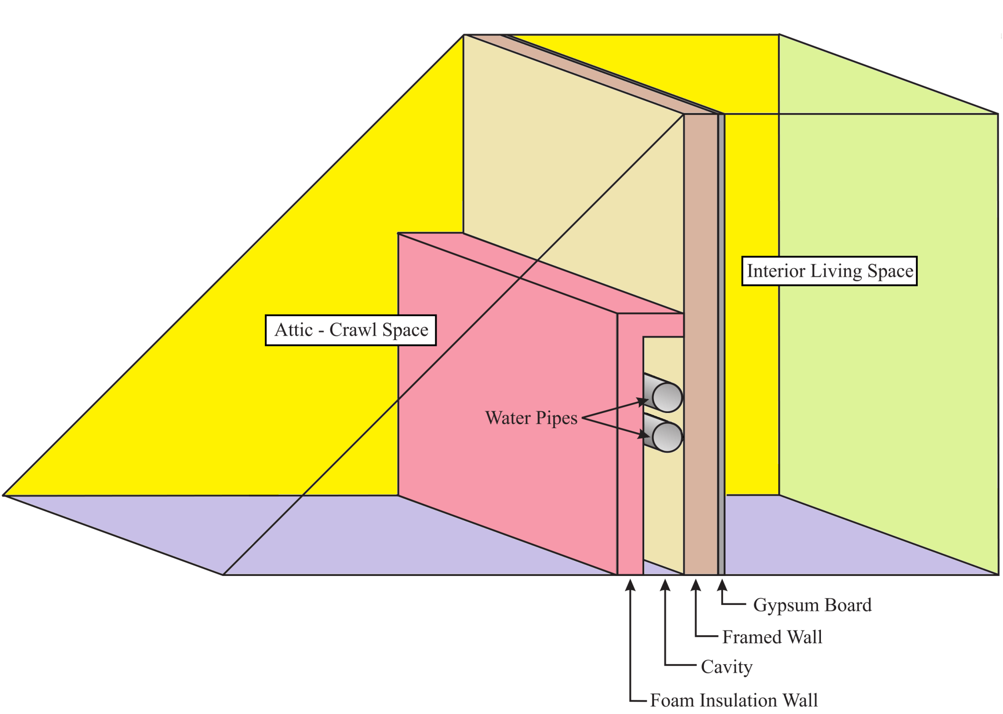

Slide 4
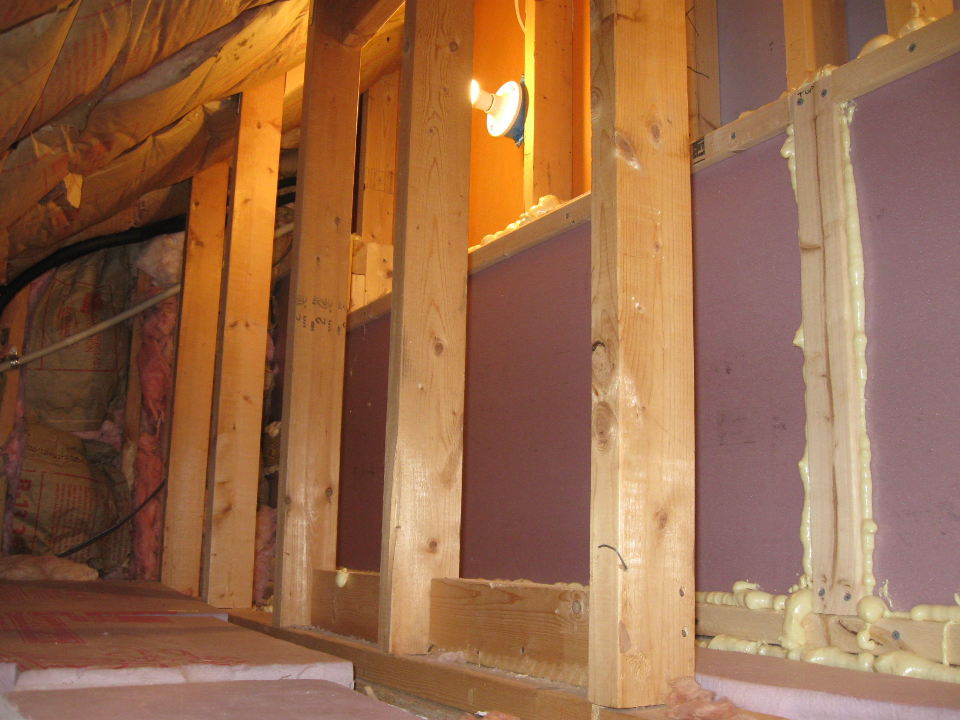

Slide 5
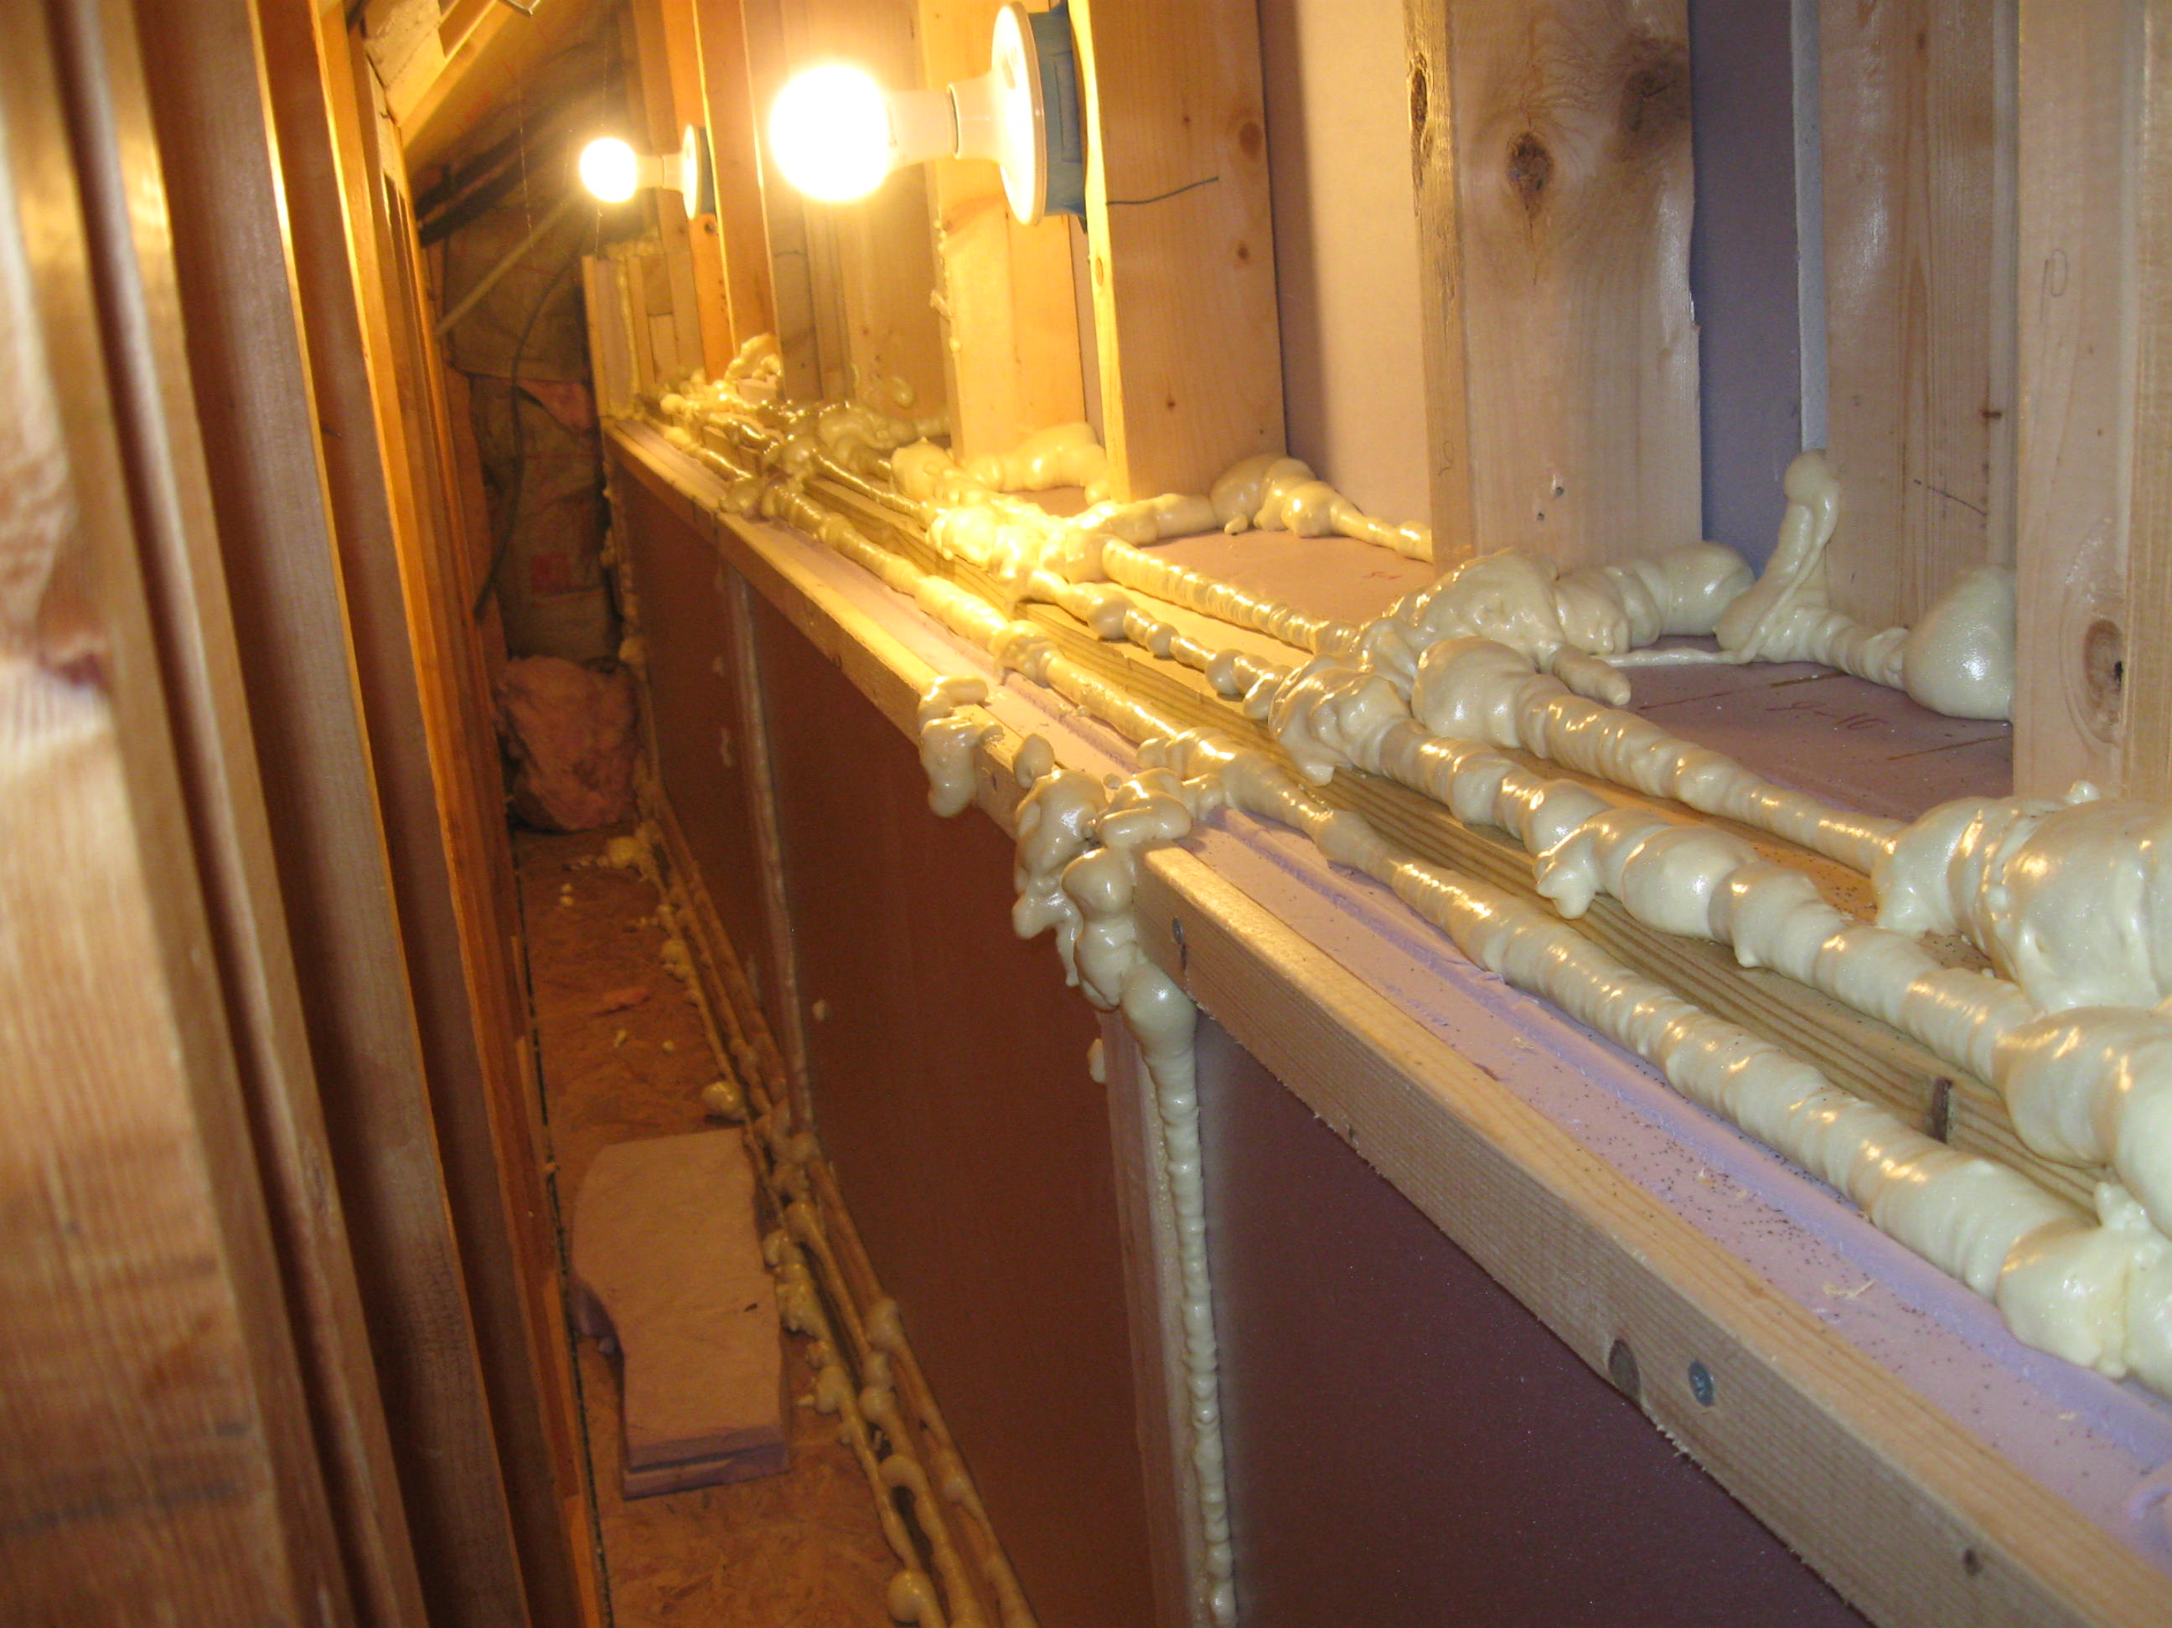

Slide 6
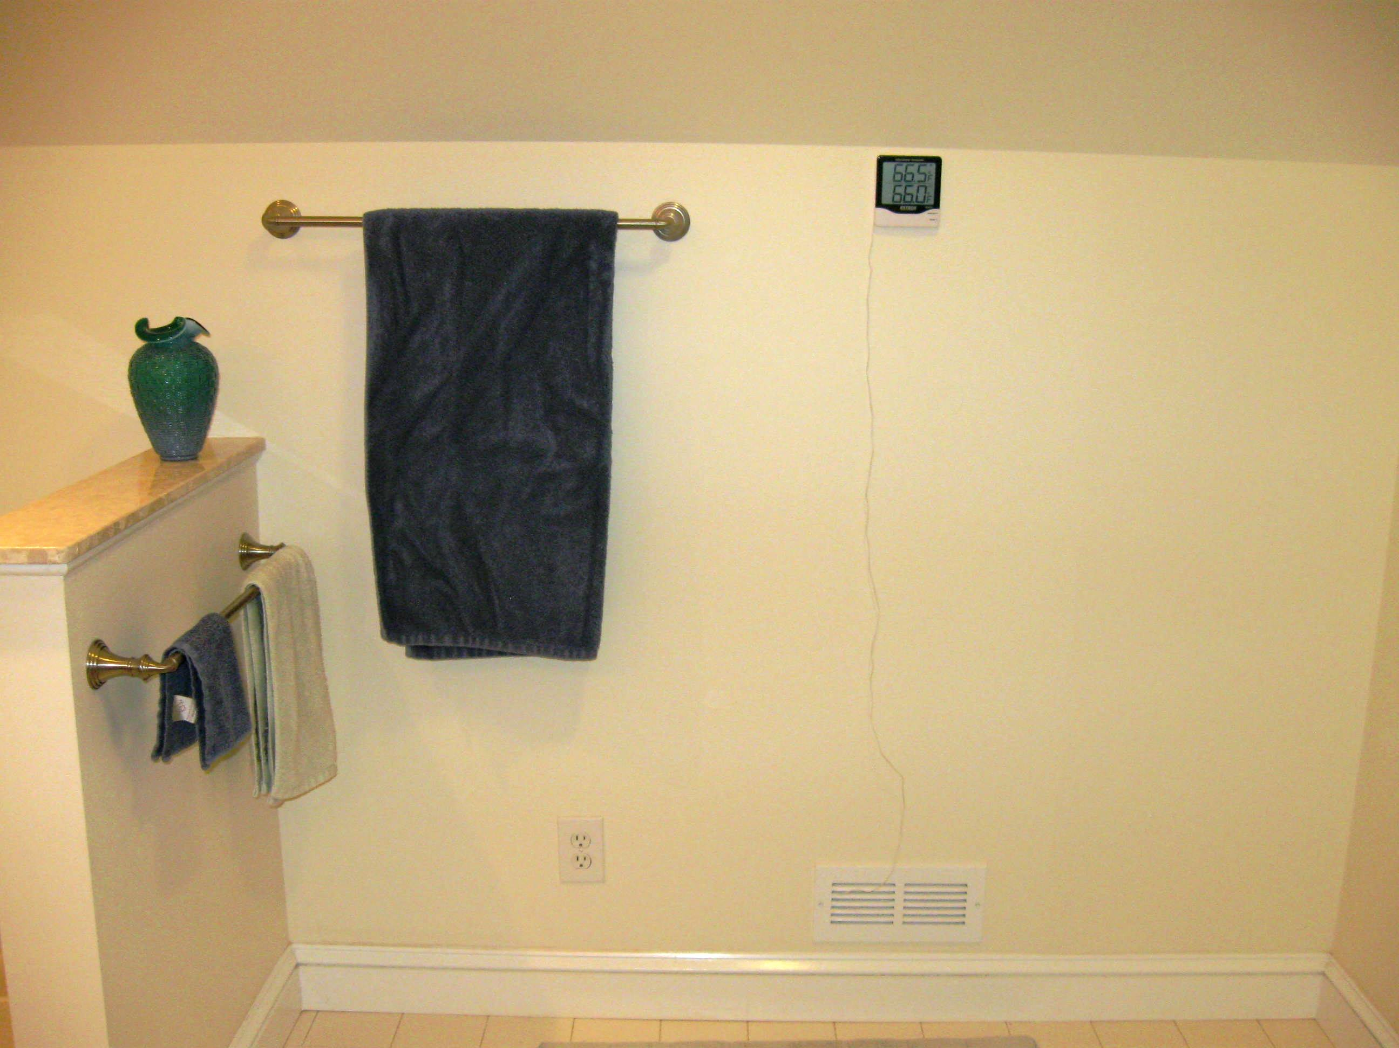

Slide 7
ODE Model
Assume Newton cooling with two ambient temperatures
The cavity interfaces with two thermal reservoirs, each at a constant temperature
Assume the rate of heat flow between each reservoir and the cavity is proportional to the temperature difference
Different proportionality constants for the two reservoirs
The constant for heat flow into the cavity is greater than the constant for heat flow out of the cavity

Slide 8
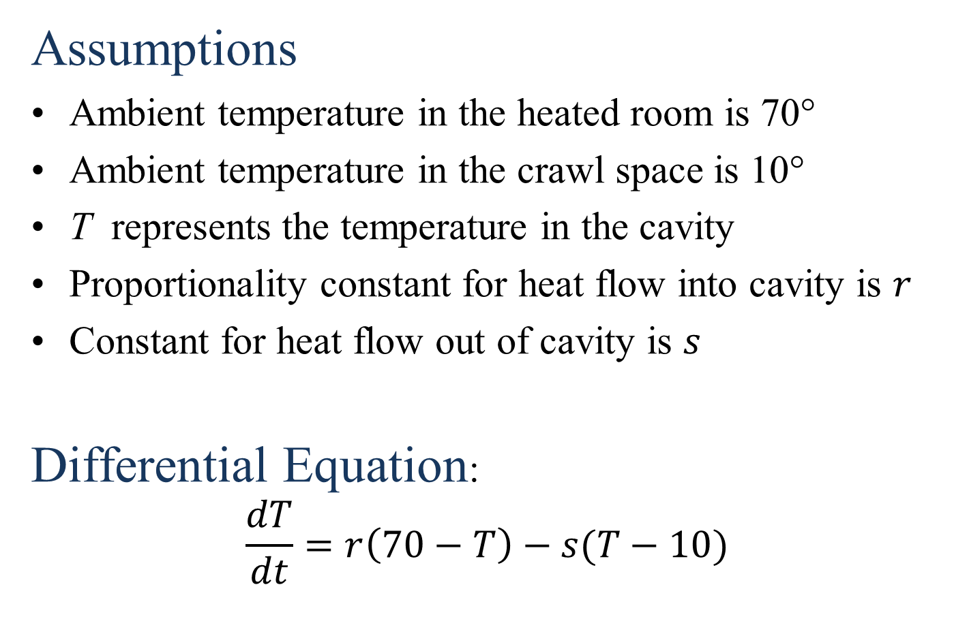
Example
Assumptions
Ambient temperature in the heated room is 70°
Ambient temperature in the crawl space is 10°
T represents the temperature in the cavity
Proportionality constant for heat flow into cavity is $r$
Constant for heat flow out of cavity is $s$
Differential Equation:
$$\frac{dT}{dt}=r\left(70−T\right)−s(T−10)$$

Slide 9
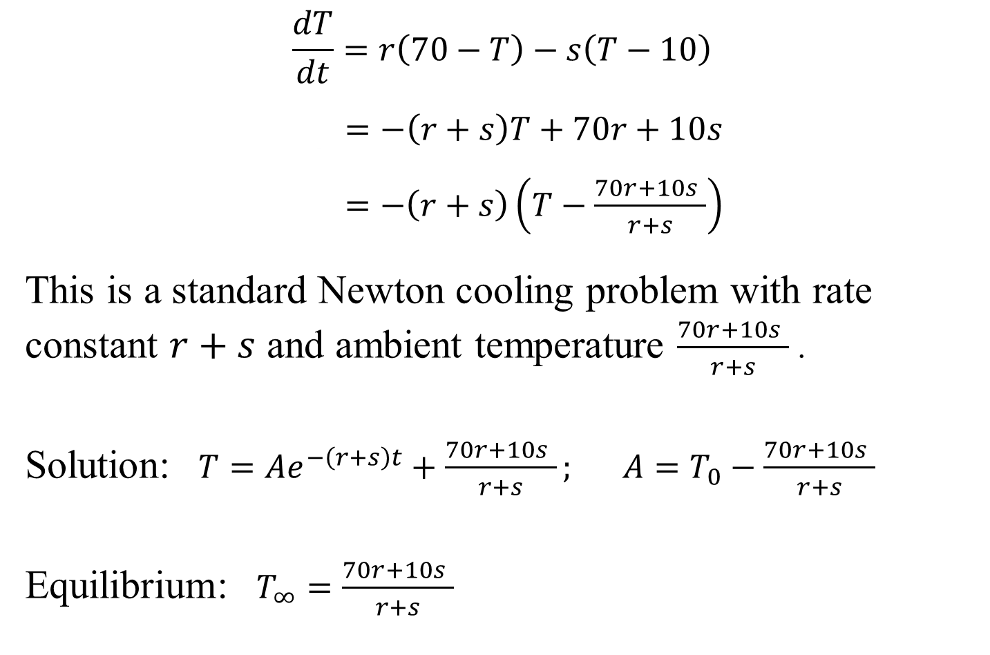
Solution
$$\frac{dT}{dt}=r\left(70−T\right)−s\left(T−10\right)$$
| $=−\left(r+s\right)T+70r+10s$
|$=−\left(r+s\right)\left(T−\frac{70r+10s }{r+s}\right)$
This is a standard Newton cooling problem with rate | constant $r+s$ and ambient temperature $\frac{70r+10s }{r+s}$ .
Solution: $T=Ae^{−\left(r+s\right)t}+\frac{70r+10s }{r+s}; A=T_{0}−\frac{70r+10s }{r+s}$
Equilibrium: $T_{∞}=\frac{70r+10s }{r+s}$

Slide 10
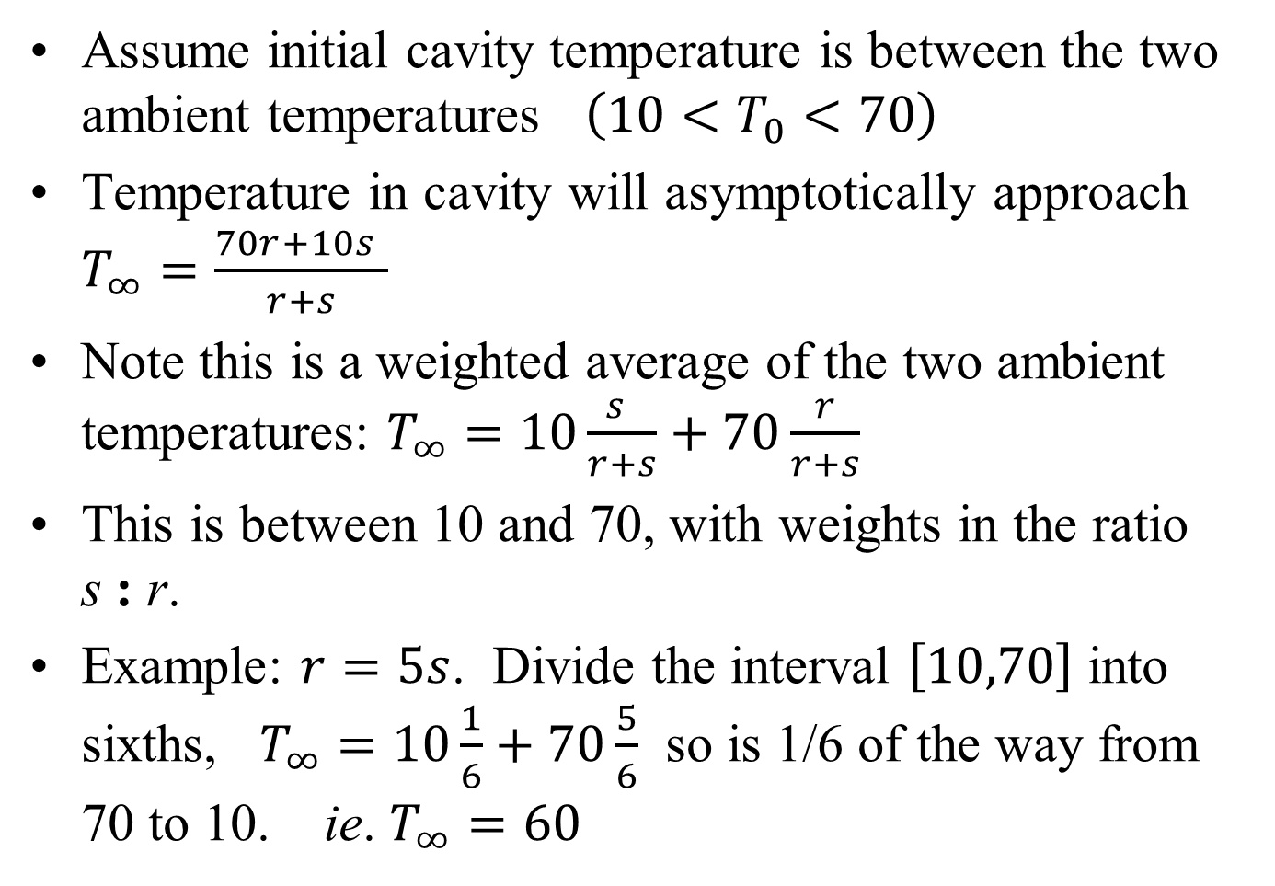
Interpretation
Assume initial cavity temperature is between the two ambient temperatures $\left(10<T_{0}<70\right)$
Temperature in cavity will asymptotically approach $T_{∞}=\frac{70r+10s }{r+s}$
Note this is a weighted average of the two ambient temperatures: $T_{∞}=10\frac{s }{r+s}+70\frac{r}{r+s}$
This is between 10 and 70, with weights in the ratio
s : r.
Example: $r=5s$. Divide the interval $\left[10,70\right]$ into sixths, $T_{∞}=10\frac{1}{6}+70\frac{5}{6}$ so is 1/6 of the way from 70 to 10. ie. $T_{∞}=60$

Slide 11
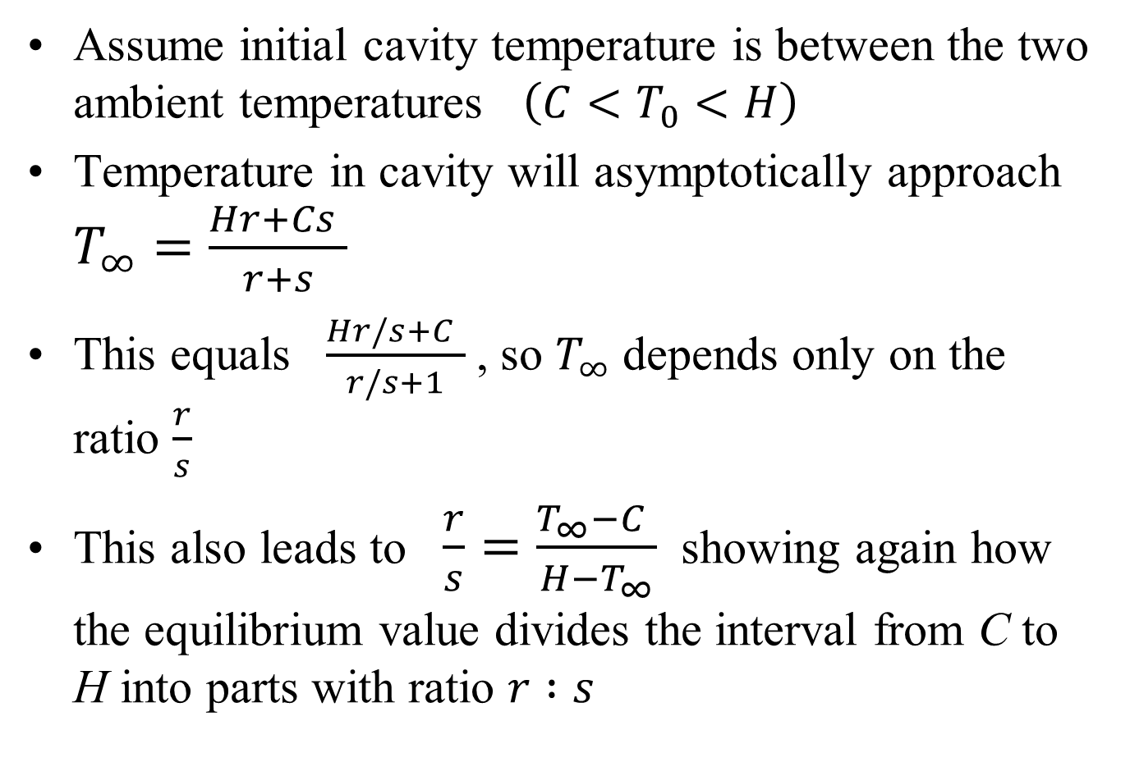
In General
Assume initial cavity temperature is between the two ambient temperatures $\left(C<T_{0}<H\right)$
Temperature in cavity will asymptotically approach $T_{∞}=\frac{Hr+Cs }{r+s}$
This equals $\frac{Hr/s+C }{r/s+1}$ , so $T_{∞}$ depends only on the ratio $\frac{r}{s}$
This also leads to $\frac{r}{s}=\frac{T_{∞}−C }{H−T_{∞}}$ showing again how the equilibrium value divides the interval from C to H into parts with ratio $r :s$

Slide 12
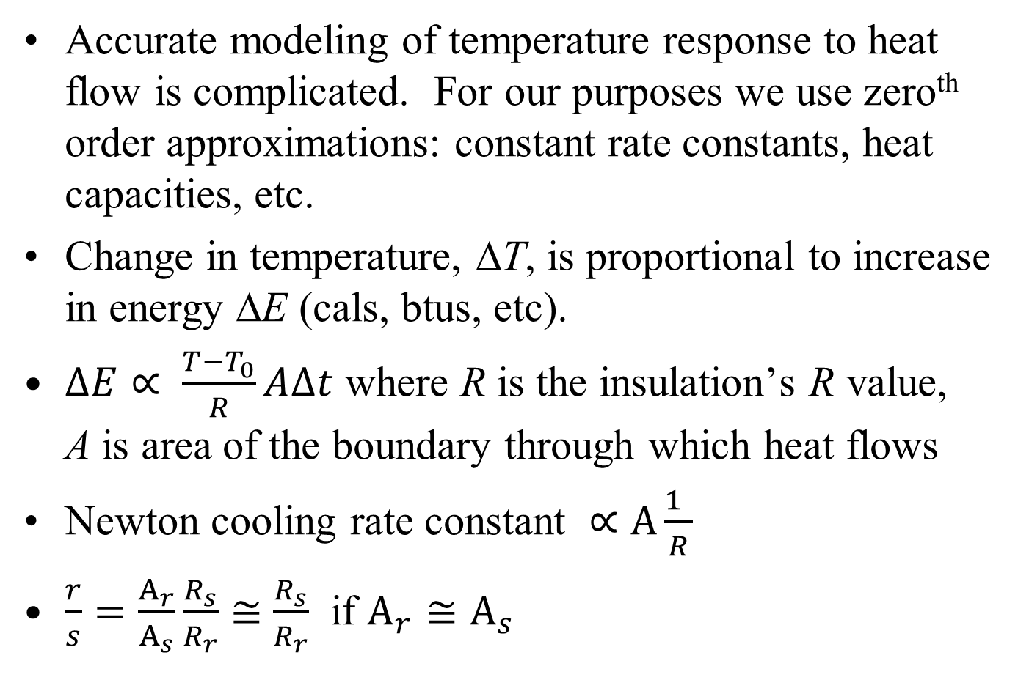
Rate constants and R values
Accurate modeling of temperature response to heat flow is complicated. For our purposes we use zero^{th} order approximations: constant rate constants, heat capacities, etc.
Change in temperature, ΔT, is proportional to increase in energy ΔE (cals, btus, etc).
$∆E∝ \frac{T−T_{0}}{R}A∆t$ where R is the insulation’s R value,
A is area of the boundary through which heat flows
Newton cooling rate constant $∝A\frac{1 }{R}$
$\frac{r}{s}=\frac{A_{r}}{A_{s}}\frac{R_{s}}{R_{r}}≅$ $\frac{R_{s}}{R_{r}}$ if $A_{r}≅A_{s}$

Slide 13
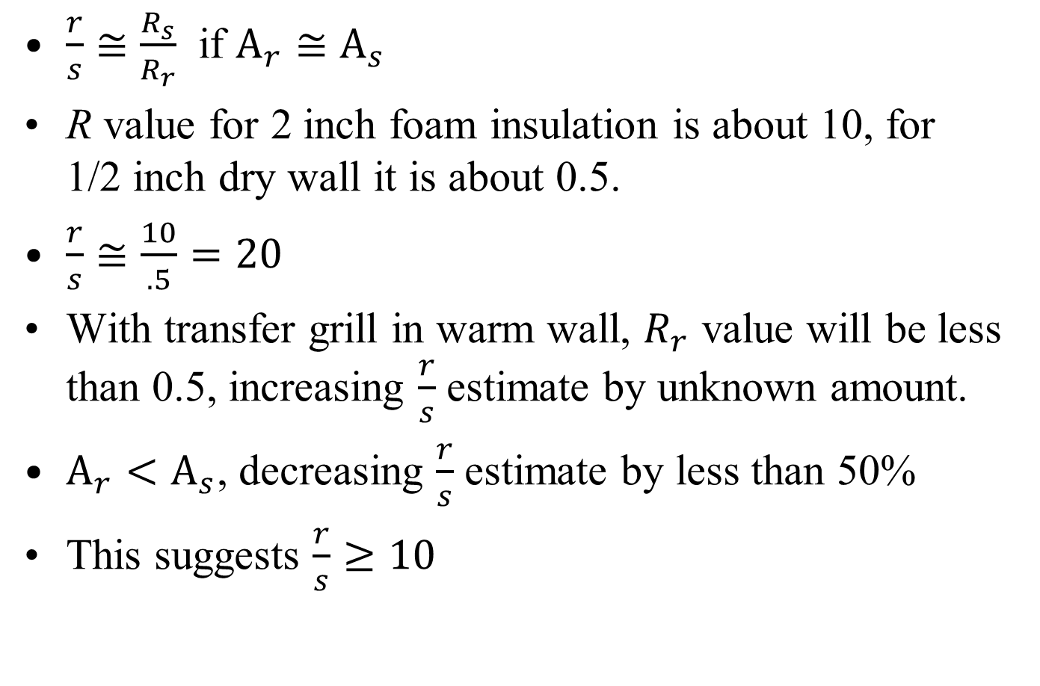
Rate constants and R values
$\frac{r}{s}≅$ $\frac{R_{s}}{R_{r}}$ if $A_{r}≅A_{s}$
R value for 2 inch foam insulation is about 10, for
1/2 inch dry wall it is about 0.5.
$\frac{r}{s}≅\frac{10}{.5}=20$
With transfer grill in warm wall, $R_{r}$ value will be less than 0.5, increasing $\frac{r}{s}$ estimate by unknown amount.
$A_{r}<A_{s}$, decreasing $\frac{r}{s}$ estimate by less than 50%
This suggests $\frac{r}{s}≥10$

Slide 14
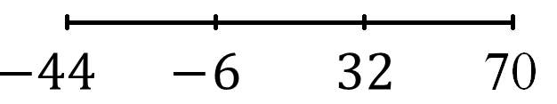
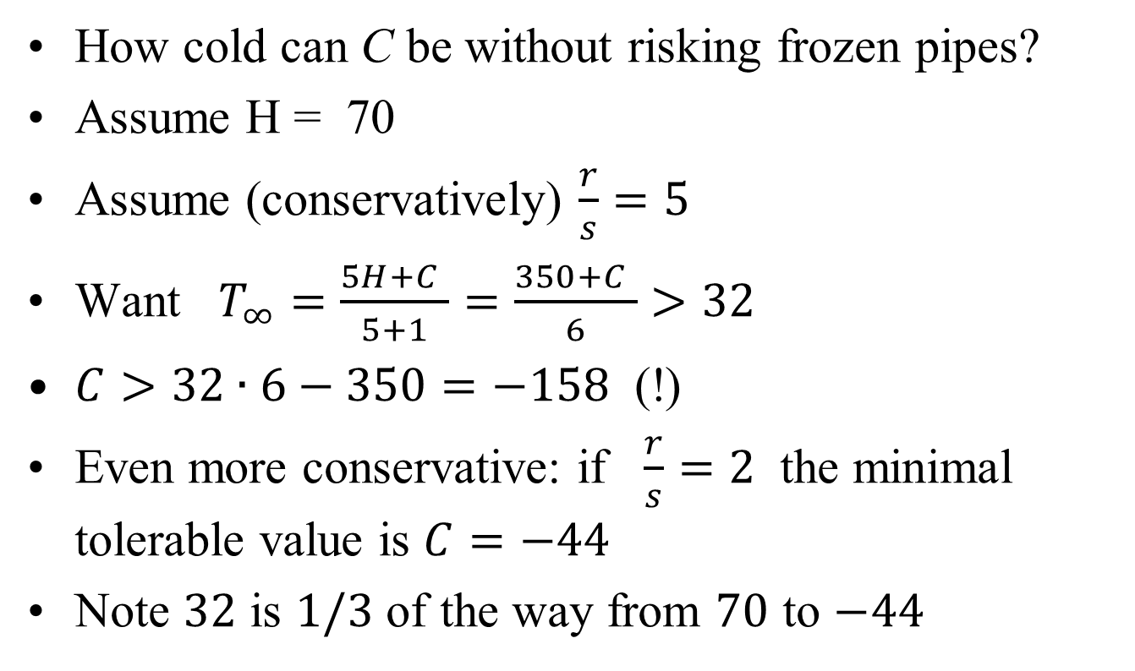
Original Question
How cold can C be without risking frozen pipes?
Assume H = 70
Assume (conservatively) $\frac{r}{s}=5$
Want $T_{∞}=\frac{5H+C }{5+1}=\frac{350+C }{6}>32$
$C>32∙6−350=−158$ (!)
Even more conservative: if $\frac{r}{s}=2$ the minimal tolerable value is $C=−44$
Note $32$ is $1/3$ of the way from $70$ to $−44$

Slide 15
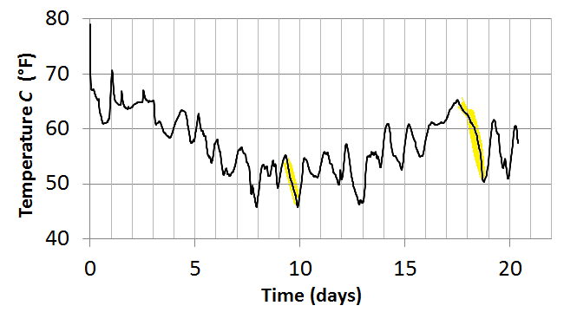
Model Validation
Ambient temp in crawl space, $C$, is not constant

Slide 16
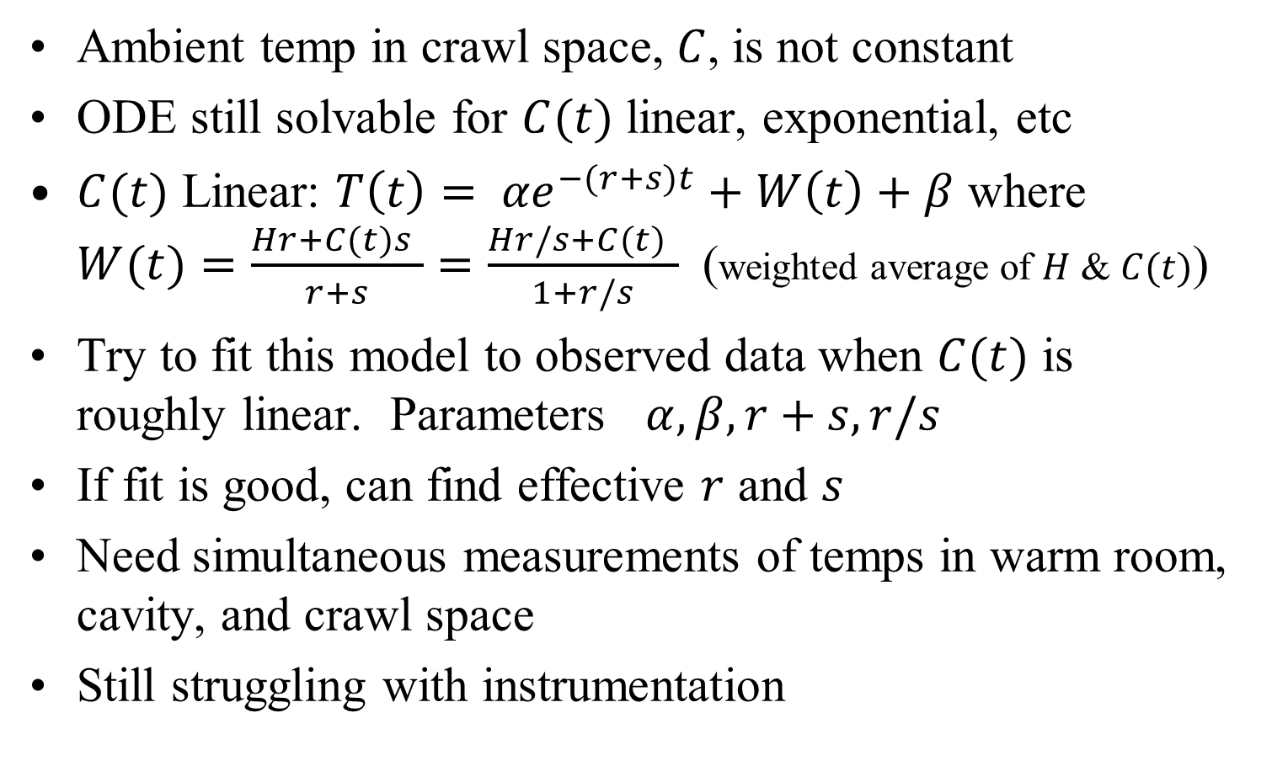
Model Validation
Ambient temp in crawl space, $C$, is not constant
ODE still solvable for $C(t)$ linear, exponential, etc
$C(t)$ Linear: $T\left(t\right)= {αe}^{−(r+s)t}+W\left(t\right)+β$ where $W(t)=\frac{Hr+C(t)s }{r+s}=\frac{Hr/s+C(t) }{1+r/s}$ (weighted average of $H$ & $C(t)$)
Try to fit this model to observed data when $C(t)$ is roughly linear. Parameters $α, β, r+s, r/s$
If fit is good, can find effective $r$ and $s$
Need simultaneous measurements of temps in warm room, cavity, and crawl space
Still struggling with instrumentation

Slide 17
Finis
Thanks
Questions?

